Slide 1
Annual Work Plan & Budget 2018-19 Mid-Day-Meal Scheme UT of Dadra & Nagar Haveli

Slide 2
Coverage of Institutions 31.3.2018
Stage | PAB Approval Schools | No of Schools Covered
Primary Schools | 162 | 161
Upper Primary Schools | 119 | 119
Grand Total (PS + UPS) | 281 | 280
Automated Monitoring System (AMS)/ SMS Based Monitoring System: - AMS has been implemented in UT of D&N.H since June-2016. Three Teachers from each school have been registered in AMS and they are doing SMS of MDM availing children on daily basis on 42,381 100% schools of UT of D &N.H are activated under AMS.

Slide 3
Student taken Part in 2017-18 31.03.2018
Stage | Approval By PAB by Central Share | Enrollment | Opted Children | % Against Enrollment | % Against PAB
Primary | 19,500 | 28,296 | 22,061 | 77.96% | 113.13%
Upper primary | 13,900 | 14,085 | 10,402 | 73.85% | 74.83%
Total | 33,400 | 42,381 | 32,463 | 76.59 % | 97.19 %

Slide 4
Graphical Representation of Coverage of Student

Slide 5
Per Unit cooking cost
Primary Section |  |  | Upper Primary Section
Central Share | UT Share | Total Per unit cost | Central Share | UT Share | Total Per unit cost
4.13 | 9.37 | 13.50 | 6.18 | 10.11 | 16.29

Slide 6
Budget Allocation Released & Expenditure of Central Share for the year 2017-18
Central Share | Allocation | Release | Expenditure
Component
Cost of Food grain | 24.48 | 24.49 | 27.68
Cooking Cost | 384.47 | 384.45 | 372.94
Transport Assistance | 6.99 | 7.00 | 6.02
Honorarium to Cook-cum-Helper | 92.50 | 92.50 | 91.57
MME (Management, Monitoring & Evaluation) | 30.00 | 30.00 | 30.00
Total | 538.44 | 538.44 | 528.21

Slide 7
School Health Programme – 2017-18
Category | Health Check up carried out |  | Distribution of Iron Folic Acid Tablets | Distribution of De-worming Tablets | Visually Impaired
 | No. of Schools /Centers | No. of Children | No. of Children | No. of Children | No. of Schools | No. of Children received spectacles | Height & Weight Measurement
PS & UPS | 280 | 42,338 | 42,338 | 42,338 | 280 | 438 | 42,338
Total | 280 | 42,338 | 42,338 | 42,338 | 280 | 438 | 42,338

Slide 8
Weekly Menu of Dadra & Nagar Haveli
Sr.No | Day | Menu
1. | Monday | Fruit (Seasonal) Vegetable Kichadi. Soyabean/Vatana with gravy. Salad : Tomatoes,Cucumber,Lemon.
2. | Tuesday | Wheat Sheera (Made out of Jaggery and Ghee) Turdal & Rice, Green Vegetable Green Salad(Onion,Tomatoes,Lemon)
3. | Wednesday | Fruit ,Shukadi (wheat flour & Jaggery) Dal and Rice ,Green Vegetable Salad :Tomatoes,Cucumber,Lemon.
4. | Thursday | Green Whole Moong along with Salad , Vegetable Khicadi, Soyabean/Vatana with gravy.
5. | Friday | Fruit(Seasonal) Lapsi Rice & Tur-dal Vegetable sabzi , salad
6. | Saturday | Sukadi , Vegetable Pulav , Soyabean /Vatana with gravy , Salad

Slide 9
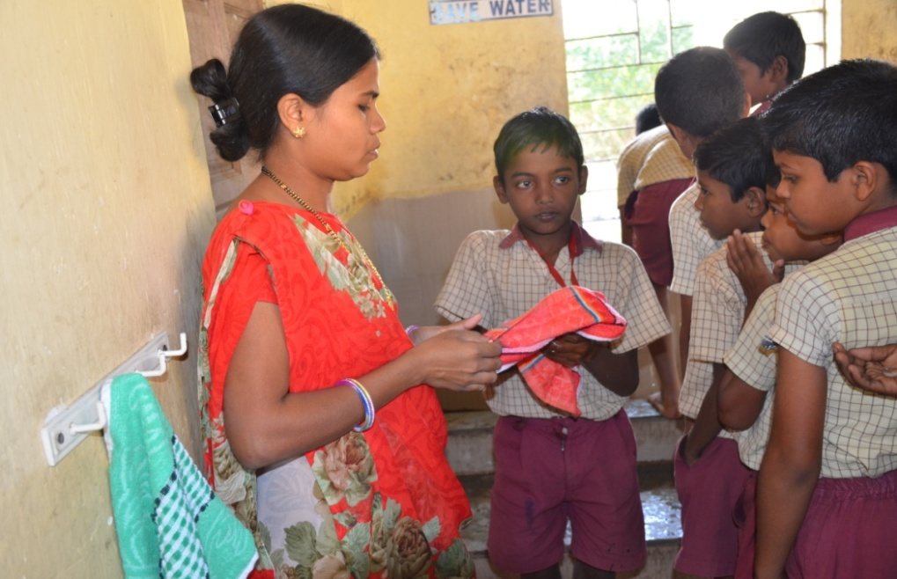
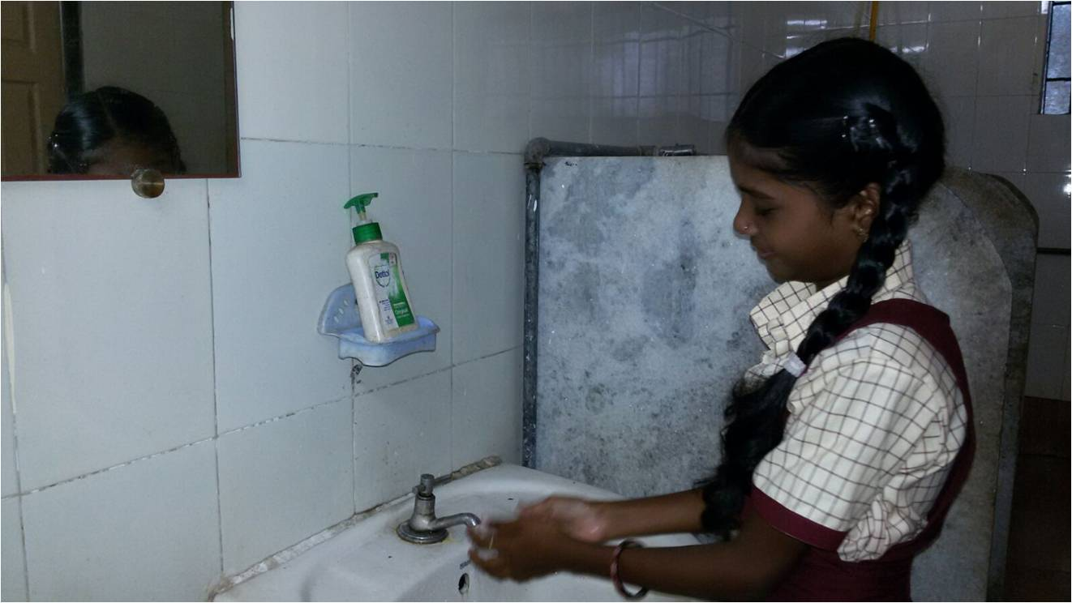
Best Practice
All the children wash their hands before and after having their Meal. Video Link

Slide 10
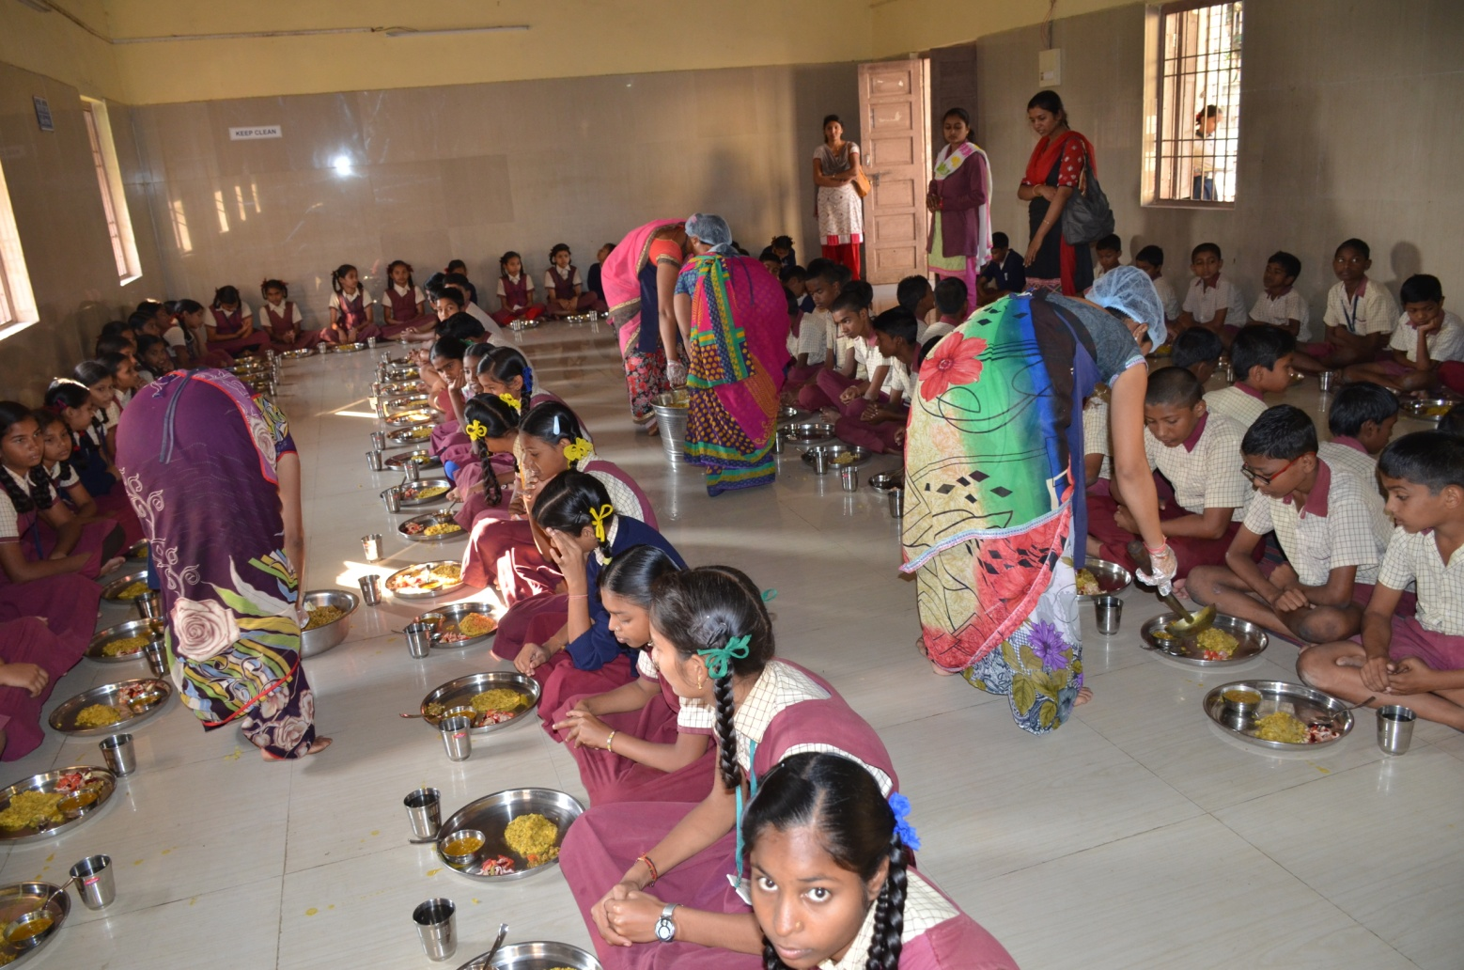
Serving of Mid Day Meal
Mid Day Meal is served in the Dinning Hall made in various schools of Dadra & Nagar Haveli under the supervision of Teachers
All the Cook cum Helpers wear hand gloves, Head cap and Apron while serving the Meal .

Slide 11
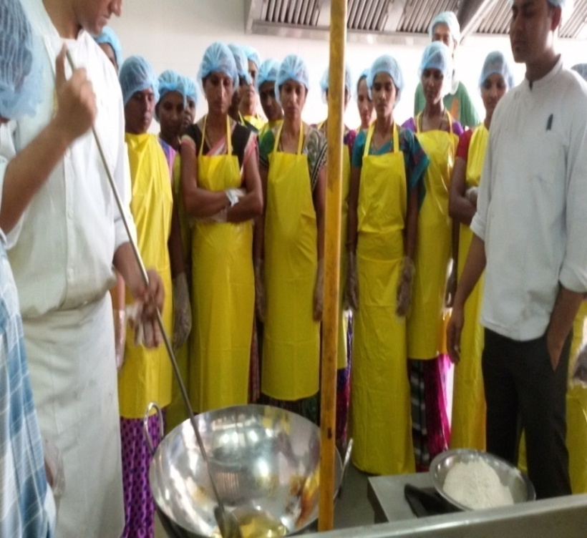
Best Practice
Trained all cooks, helpers and other functionaries in hygienic habits like regular cutting of nails, washing of hands and feet with liquid soap before commencement of cooking/serving etc.

Slide 12
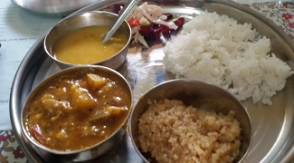
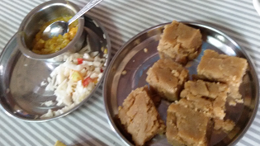
Best Practice
Sweet Dish served four times in a week such as (Sukhadi, Sheera and Lapsi).

Slide 13
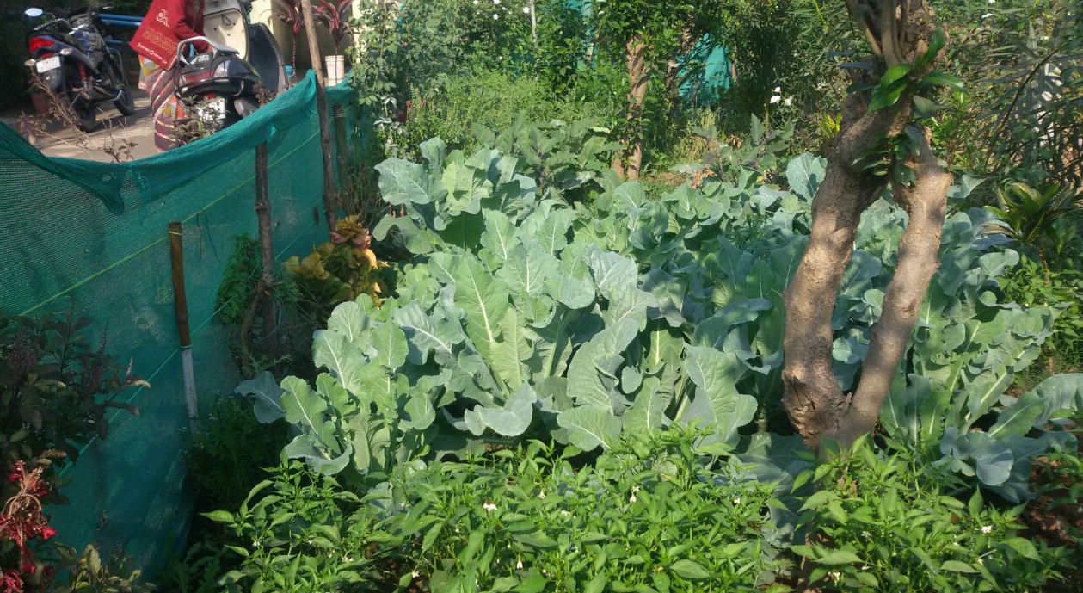
Kitchen Garden

Slide 14
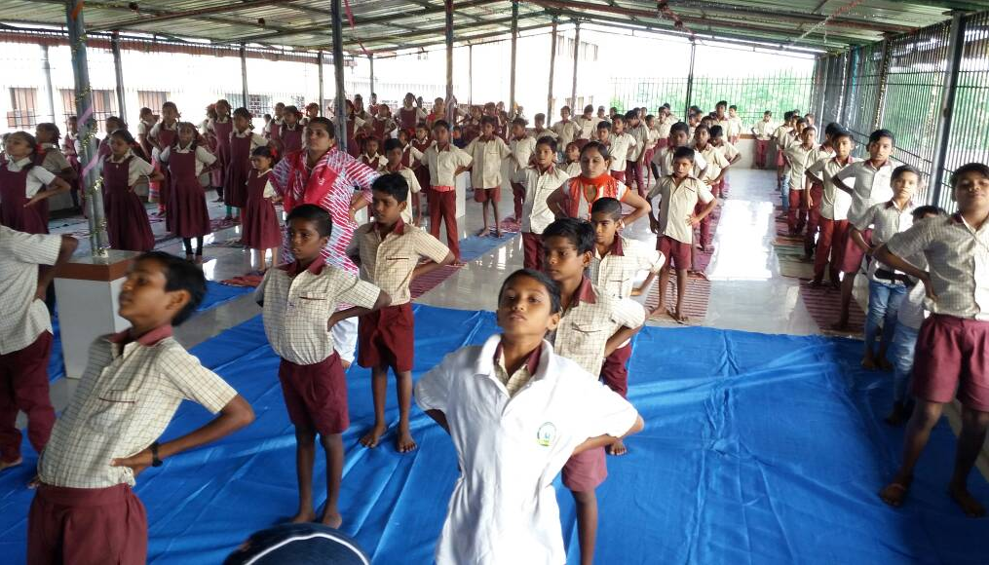
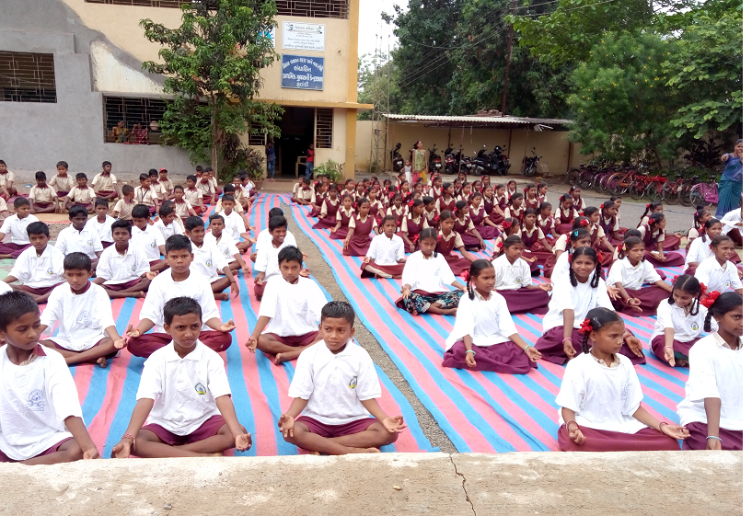
Yoga & Meditation
Before Conducing Prayer everyday Yoga and Meditation is practiced in each school for around 20 Minutes.

Slide 15
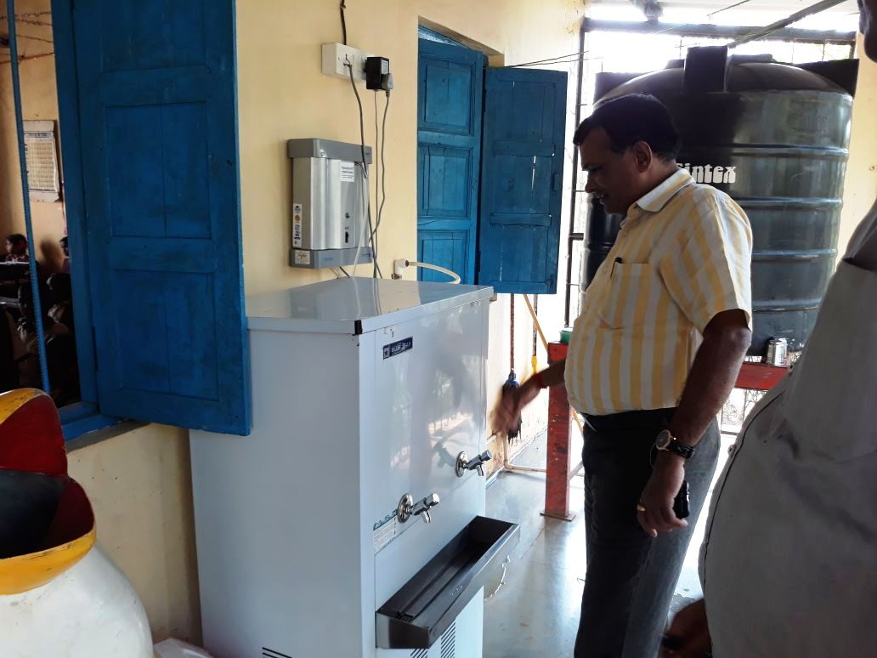
Best Practices Followed in the ut of Dadra & Nagar haveli
RO plant is installed in 79 schools of Dadra & Nagar Haveli. From July 2018, treated water will be provided in various schools of Dadra & Nagar Haveli.
S

Slide 16
Best Practices Followed in the ut of Dadra & Nagar haveli
Since all the Master Trainer Cooks from each schools have been trained by IHM-Silvassa they further train the other cooks.
Health Check-up was conducted by the Health Department of all the Cook- Cum Helpers.
All the Cook-cum-Helpers follow hygienic habits like regular cutting of nails, washing of hands and feet with liquid soap before commencement of cooking/serving etc.
Tasting of food by teachers on rotation basis is made compulsory and the record is kept in register on daily basis at school level.
In addition to Central Share, Cook-cum-Helper is provided half day payment of Rs. 151.75 per day x No. of working days from UT share.
Sanitary Napkins are provided to all the Girls studying in class VI th to VIII.

Slide 17
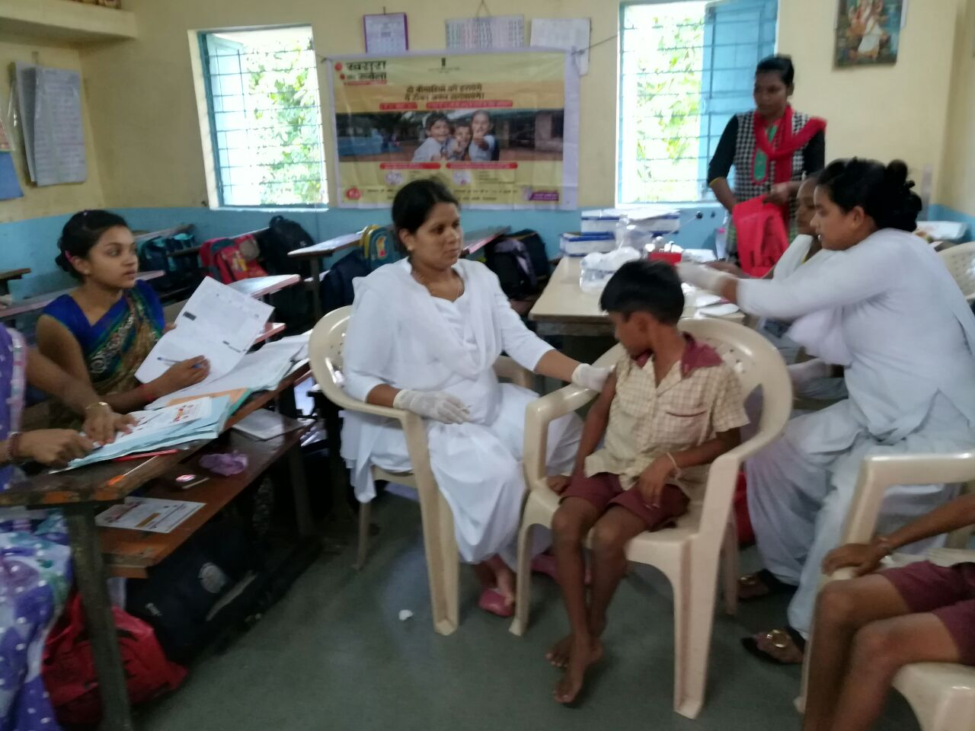
All students are covered under School Health Program scheme of Govt. of India.

Slide 18
Proposal for the year
2018-19

Slide 19
Proposal for the year 2018-19
 | Existing Enrollment | Children availing MDM | Proposed
No. of Schools | 280 | 280 | 280
Children (Pry) | 28296 | 22061 | 24,280
Children (U Pry) | 14085 | 10402 | 11,500
Working Days | 231 | 240 | 244
Cook-cum-Helper | 925 | 925 | 926

Slide 20
Component wise proposal for 2018-19 Central And UT Share
Component | Proposed (Rs. in Lakhs)
Food Grain in MTs | (1013.332Mts)
Cost of Foodgrain | 30.70
Cooking Cost | 1256.86
Honorarium of Cook Helper | 342.82
Transportation | 7.58
MME | 30.00
Kitchen Devices | 14.00
Total | 1681.96

Slide 21
Thank You ...

